Slide 1
Client Project
Project Governance Scorecard

Slide 2
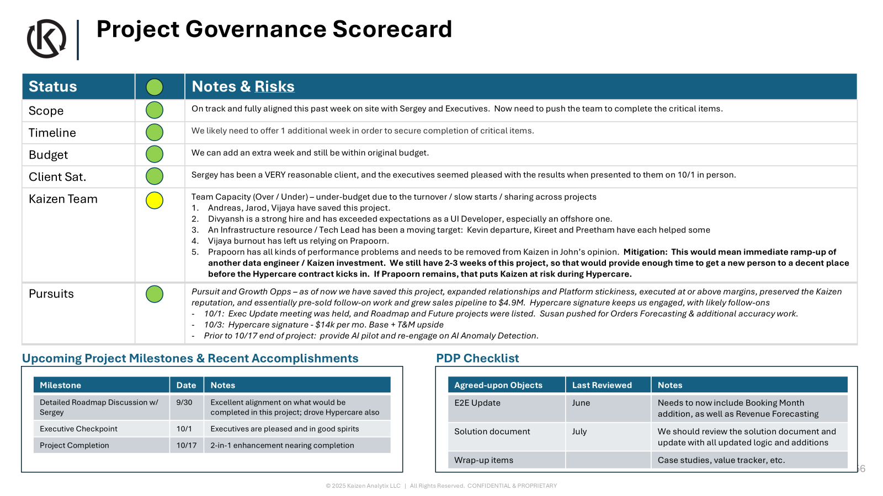
Project governance: Project governance scorecards
Purpose: EL maintains a project scorecard, to be reviewed during project governance meetings. Scorecard to provide status along difference project considerations along with notes and risks. Also include updates on recent accomplishments and upcoming milestones, along with updates to PDP checklist.
Frequency: Ongoing
Timing: present during monthly project governance meeting (or as per meeting schedule)
Steps
  Obtain project governance scorecard template
  Update scorecard template with current month details. Work with project team members, as needed
    Status along dimensions of scope, timeline, budget, client satisfaction, Kaizen Team, and sales pursuits
    Provide a summary of recent accomplishments and upcoming milestones
    True up PDP checklist – list of items on right
  Present the scorecard during project governance meetings
Keep following artifacts up-to-date at all times. Update status before monthly project governance calls (PDP checklist). Refer project artifact slides for details.
Project Teams site
Project Confluence site
RAID log
Business Continuity Plan
End To End Diagram
System Architecture Diagram
Value Tracker
Case study
Criteria for success
Project governance scorecard updated regularly
Scorecard being leveraged in project governance meeting

Slide 3
Project Scorecard
Trade Vault
1/26/2026
Status |  | Notes & Risks
Scope |  | On track to complete what we had signed up for in the SOW. Our work has extended to other high impact areas to help mitigate impact of tariff volatility (Section 232 lookback analysis...
Timeline |  | On time to deliver as per contract terms
Budget |  | Pending SOW. but the client has verbally approved an additional budget.
Client Sat. |  | The client has a high level of trust in us and is extremely satisfied with the quality of work we deliver, especially in the current tariff conditions.
Kaizen Team |  | All members are fully allocated: Nikhil, Abul, John, Austin, Teja. .. Pradeep , Jay, (limited time)
Pursuits |  | FTZ strategy → conversion to implementation. High velocity project. → Pending approval for FY26 extension and initial discussions on the FY27 project plan Support for Control Tower platform → envision project proposal for FY27 Tariff Platform work in alignment with Magellan 2.0 Toyota initiative Confident of FY27 extension Approval of Additional Budget for FY26
Upcoming Project Milestones & Recent Accomplishments
PDP Checklist
Milestone | Date | Notes
Completed monthly refresh of TradeVault and initiated regular monthly activities | 1/15 | DEC ACE and broker data integration (imports of $ 4 B, and exports), duty payment report, other standardized output
Section 232 Tariff Lookback Analysis | 1/26 | Kaizen identified savings of $ 18 m for Mar ’25. Produced executive dashboard for Peter and other senior Toyota execs
Enhanced Duty Payment Reports | 1/26 | Facilitating tariff impact analysis by different Toyota groups – CTC, Accounting, Purchasing, Supplier Services, and more
Agreed-upon Objects | Last Reviewed | Notes
E2E | Jan 2026 | TradeVault Playbook: Lucidchart
Value Tracker | Jan 2026 | Updating monthly based on changing tariffs TradeVaultProject_BenefitsTracker_.xlsx
Technical Solution Architecture | Jan 2026 | TradeVault_Architecture.pptx
JIRA Board | Dec 22, 2025 | JIRA board being maintained for Kaizen activities on Toyota sideSummary - TradeVault - Jira

Slide 4
Project Governance Scorecard
Project Name
Date
Status |  | Notes & Risks
Scope
Timeline
Budget
Client Sat.
Kaizen Team
Pursuits
Upcoming Project Milestones & Recent Accomplishments
PDP Checklist
Milestone | Date | Notes
Agreed-upon Objects | Last Reviewed | Notes
RAID Log
Business Continuity Plan
End to End Diagram
System Arch Diagram
Value Tracker
Case Study

